Slide 1
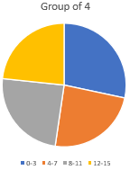
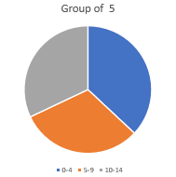
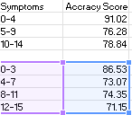
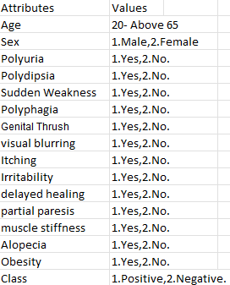
Likelihood Prediction of Diabetes at an Early Stage using Data Mining Techniques
Author: Chasity Harris Charr109@bulldogs.aamu.edu Advisor: Dr. Xiang(Susie) Zhao email: xiang.zhao@aamu.edu
Department of Electrical Engineering and Computer Science
RESULTS
ABSTRACT
The results were based on the symptoms of diabetes that will give us the most accurate early detection of the disease. And the symptoms there were only two high accuracy scores from all 15 symptoms. 0-4 and 0-3; and this is how I got the accuracy scores.
• I did two tables one I grouped the columns in groups of 5 and the second one I grouped the columns in groups of 4.
• From table 1 the columns that gave the highest accuracy score are columns 0-4 with a score of 91.02; Symptoms were:
-Age/ Gender/ Polyuria/ Polydipsia/ Sudden weakness
• From table 2 the columns that gave the highest accuracy score are columns 0-3 with a score of 86.53; Symptoms were:
- Age/ Gender/ Polyuria/ Polydipsia
Diabetes Mellitus is a chronic metabolic disorder, one of the fastest growing life-threatening diseases that have already affected 422 million people worldwide according to the report of World Health Organization (WHO). It creates health crises of this era despite racial, geographic or ethic context. Due to the presence of a relatively long asymptomatic phase, early detection of diabetes is always desired for a clinically meaningful outcome. Around 50% of all people suffering from diabetes are undiagnosed because of its long-term asymptomatic phase. Then the diabetic complication might become severe and hard to treat after the patients get diagnosed eventually. Therefore, early prediction and diagnosis are highly desired. In this project, data mining techniques are used to generate a solution to early likelihood prediction of diabetes. In this study, both a Decision Tree and a Support Vector Machine (SVM) classifiers have been implemented in Python. A decision tree is when a dataset is broken down into smaller and smaller subsets while at the same time an associated decision tree is incrementally developed. And is this research we used J48 decision tree. And then the SVM a computer algorithm that learns by assigning labels to the objects in the subsets. The classifiers have been trained and tested using real-world diabetes patient datasets that include features. For example, this dataset has been created from a direct questionnaire to people who have few or more symptoms. The experiment results indicate that both classifiers demonstrated high accuracy in predicting the diabetes. Future research will investigate the accuracy of ensemble classifiers, such as Random Forest.
KEYWORDS: Decision Tree, Support Vector Machine, Data Mining, Data Analysis, Classification, Diabetes Prediction
CONCLUSION
In conclusion having early detection not only benefit those living with it but will bring awareness to the world that this is a slow growing big problem worldwide, and we need to start educating not only adults but our children as well to ensure our future (children). Since diabetes effects children and younger adults more than older adults. And this can or will be used for other diseases as well in the future along with improving our medical field.
INTRODUCTION
REFERENCES
This research project is very important due to the mass growth of technology along with fast food places. In addition, most people don’t realize they have Diabetes until its either too late or becomes chronic. And the fact that it’s very aggressive in our children and younger adults that the actual grown adults. But I believe with this early detection will pave the way for something even greater than a diagnosis.
- “Likelihood Prediction of Diabetes at Early Stage Using Data Mining Techniques”- M.M. Faniqul, etc.
- Python-Sklearn/ Anaconda / YouTube
ACKNOWLEDGEMENTS
Special thanks to the Department of Education MSEIP for this amazing opportunity to conduct the research that I can relate to through my grandad. And a huge thanks my mentor Dr. Xiang Zhao for making this research a smooth process along with making it enjoyable.
TECHNICAL APPROACH
TECHNICAL APPROACH
-Data set-
-Support Vector Machine (SVM)-
Code segments of the SVM used in this project
#get all categorical columns
cat_columns = balance_data.select_dtypes(['object']).columns
#convert all categorical columns to numeric
balance_data[cat_columns] = balance_data[cat_columns].apply(lambda x: pd.factorize(x)[0])
X = balance_data.values[:, 12:15]
Y = balance_data.values[:,16]
X_train, X_test, y_train, y_test = train_test_split( X, Y, test_size = 0.3, random_state = 100)
-accuracy score-
Code segments to calculate the accuracy score
~ here is the code used to get the accuracy score:
y_pred_en = clf_entropy.predict(X_test)
y_pred_en
print ("Accuracy is "), accuracy_score(y_test,y_pred_en)*100
-Decision Tree Code-
Code segments of the decision tree used in this project
from sklearn.tree import DecisionTreeClassifier
~clf_entropy = DecisionTreeClassifier(criterion = “entropy”, random_state = 100, max_depth = 3, min_samples_leaf = 5)
clf_entropy.fit( X_train,y_train)
~DecisionTreeClassifier( class_weight = None, criterion = ‘entropy’, max_depth = 3, max_features = None, max_leaf_nodes = None, min_impurity_decrease = 0.0, min_impurity_split = None,min_samples_leaf = 5, min_samples_split = 2,
min_weight_fraction_leaf = 0.0, presort = False,
random_state = 100, splitter = ‘best’)

